Slide 1

Bright Coffee Shop Sales Analysis
Data-driven insights for growth
Prepared by: BM Mokoka

Slide 2
Project Overview
Objective: Identify sales trends and opportunities
Tools Used: miro.com → Planning
Databricks: Data cleaning, analysis & visualization
Power Point: Presentation
Scope: Store performance, time-of-day revenue, product categories

Slide 3
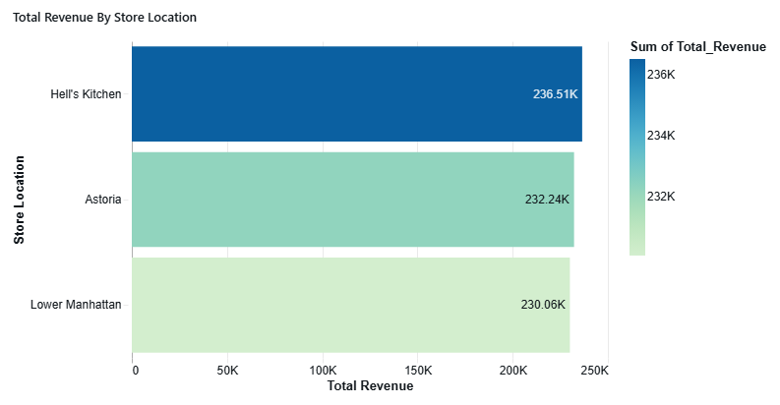
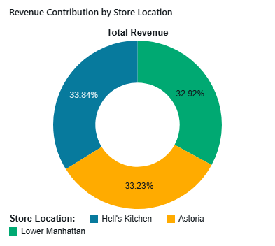
Store Performance
Hell’s Kitchen: R236.51k (top performer)
Astoria: R232.24k
Lower Manhattan: R230.06k
Insight: Balanced revenue distribution across stores
Recommendation: Maintain consistent marketing and operations

Slide 4
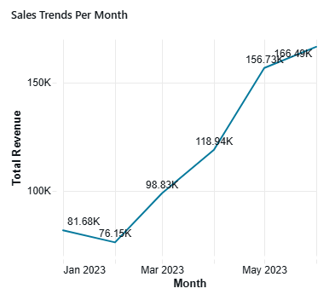
Sales Trends Over Time
January: R81.68k to May: R166.49k
Steady growth across months
Insight: Seasonal or promotional factors boosted April–May
Recommendation: Replicate successful campaigns during peak months

Slide 5
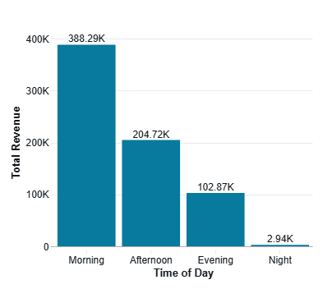
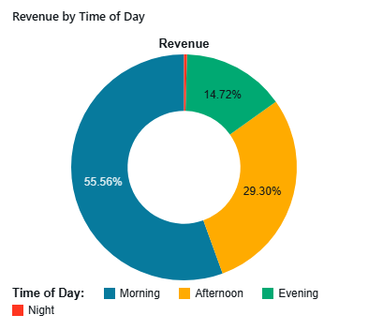
Revenue by Time of Day
Morning: 55.56% (R388.29k)
Afternoon: 29.30% (R204.72k)
Evening: 14.72% (R102.87k)
Night: 0.42% (R2.94k)
Recommendation: Increase staffing during morning rush
Introduce afternoon specials to boost mid-day sales

Slide 6
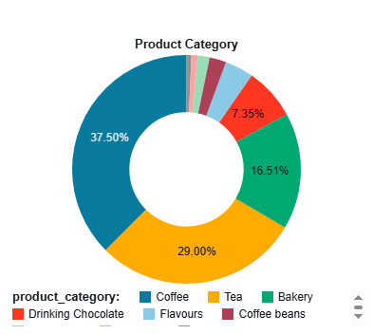
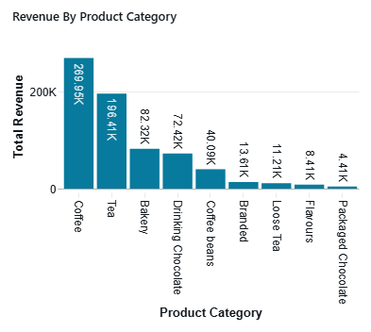
Product Category Performance
Coffee: R299.95k (top seller)
Tea: R196.41k
Bakery: R82.23k
Drinking Chocolate: R72.42k
Low performers: Chocolate, Profiteroles, Pie
Recommendation: Promote specialty coffees and teas
Bundle low-performing items with popular products

Slide 7
Key Recommendations
Optimize staffing for peak hours
Replicate successful monthly campaigns
Focus marketing on top-selling products
Introduce combo deals for underperforming categories
Introduce products that will attract the change in seasonal preferences, e.g. Ice tea and ice coffee for summer months.

Slide 8
Conclusion
Bright Coffee Shop shows consistent growth
Balanced store performance across locations
Data-driven decisions can enhance profitability and customer experience

